Slide 1
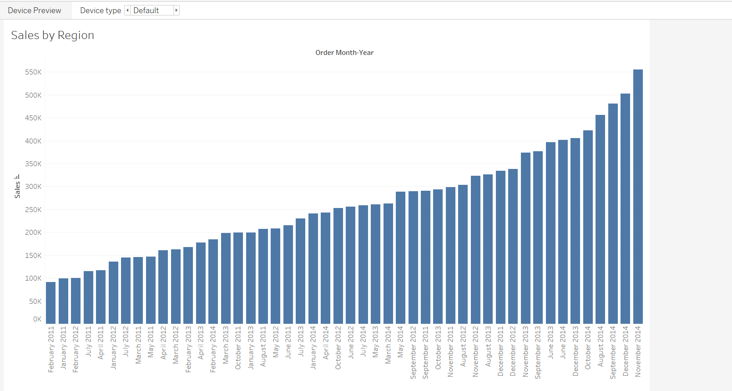
Sheet 1: Sales by Region (Bar Chart)

Slide 2
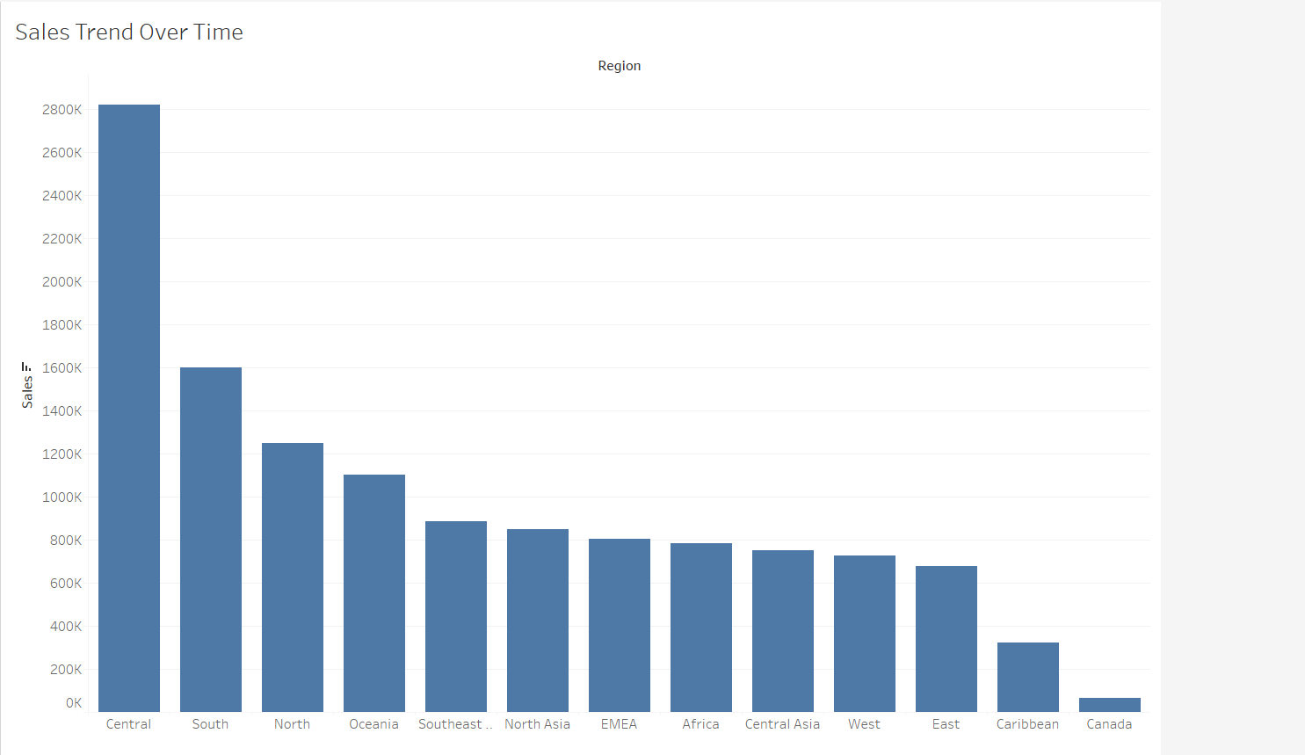
Sheet 2: Sales Trend Over Time (Line Chart)

Slide 3
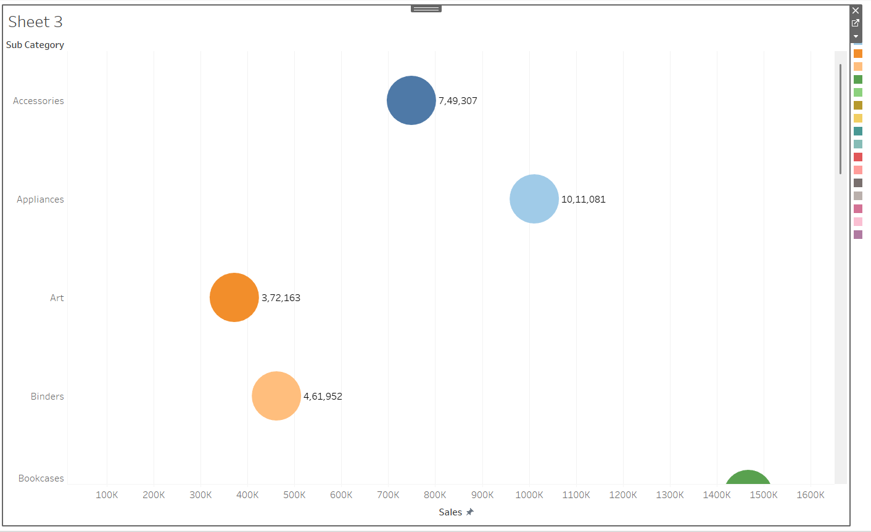
Sheet 3: Sales by Sub-Category (Pie Chart)

Slide 4
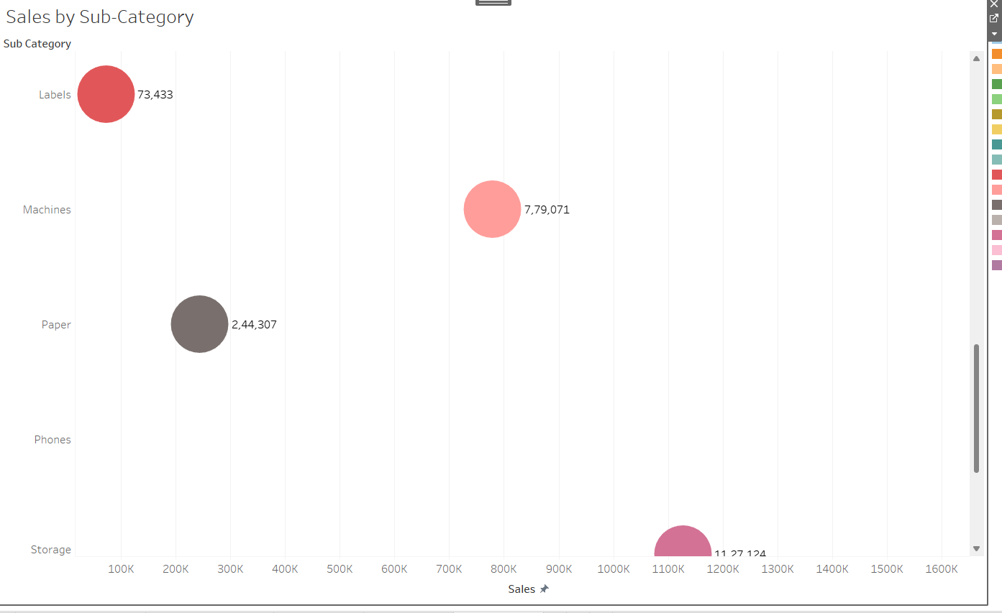

Slide 5
